Slide 1
Operators and Expressions

Slide 2

Table of contents
01
03
Operators
02
Operator Precedence
Expressions

Slide 3


01
Operators

Slide 4
Operators
Arithmetic Operators
+, -, *, /, %, **, //
Assignment Operators
=, +=, -=, *=, /=, %=, //=, **=, &=, |=, ^=, >>=, <<=, :=
Comparison Operators
==, !=, >, <, >=, <=

Slide 5
Operators
Logical Operators
and, or, not
Identity Operators
is, is not
Membership Operators
in, not in
Bitwise Operators
&, |, ^, ~, <<, >>

Slide 6
02
Operator Precedence

Slide 7
Operator Precedence
()
**
+x, -x, ~x
*, /, //, %
+, -
<<, >>
&
^
|
-> Parantheses
-> Exponentiation
-> Unary plus, minus & bitwise NOT
-> Multiplication, division, floor division & modulus
-> Addition & Subtraction
-> Bitwise left & right shifts
-> Bitwise AND
-> Bitwise XOR
-> Bitwise OR

Slide 8
Operator Precedence
==, !=, >, >=, <, <=, is, is not, in, not in
not
and
or
-> Comparisons, Identity & membership operators
-> Logical NOT
-> AND
-> OR

Slide 9
03
Expressions

Slide 10
Expressions
An expression is a combination of operators and operands(variables or constants on which the operators work) that is interpreted to produce some other value.
Constant Expressions:
Has only constant values.
x = 3+5
print(x)

Slide 11
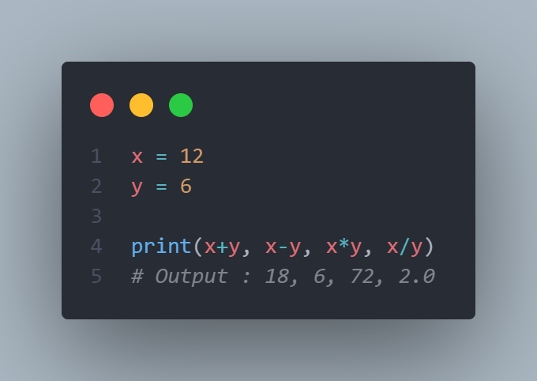
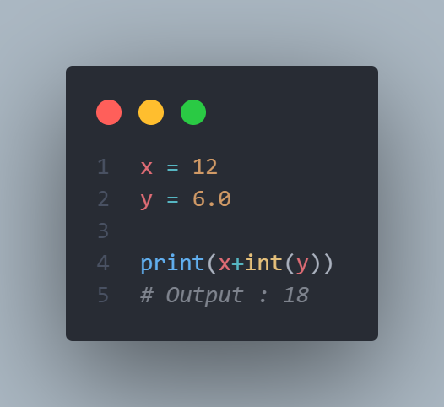
Expressions
Arithmetic Expressions:
Combination of numeric values, operators & sometimes paratheses. The result is a numeric value.
Integral Expressions:
Produce only integer results after all computations and type conversions.

Slide 12
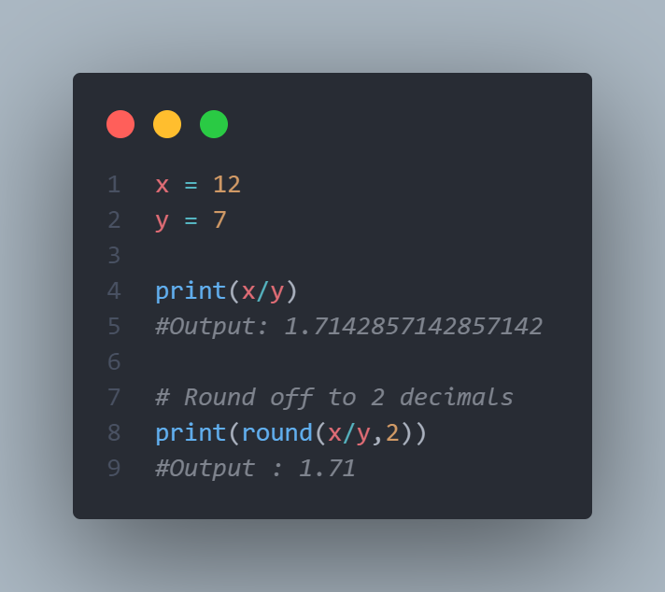
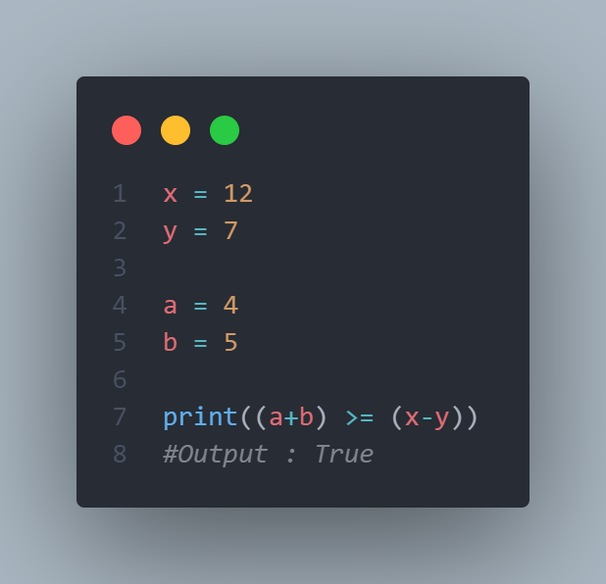
Expressions
Floating Expressions:
Produce floating point numbers as result after all computations and type conversions.
Relational Expressions:
Arithmetic expressions are evaluted first and then compared to relational operation and produce boolean output.

Slide 13
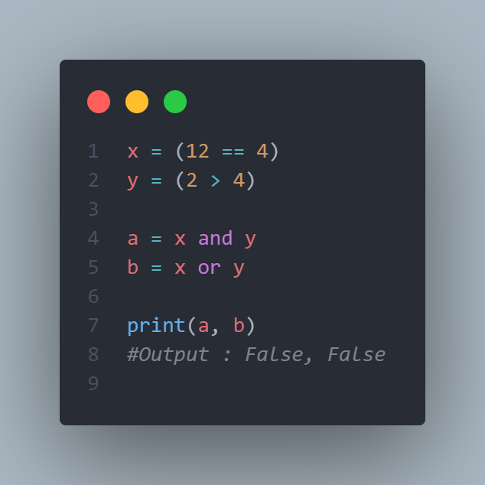
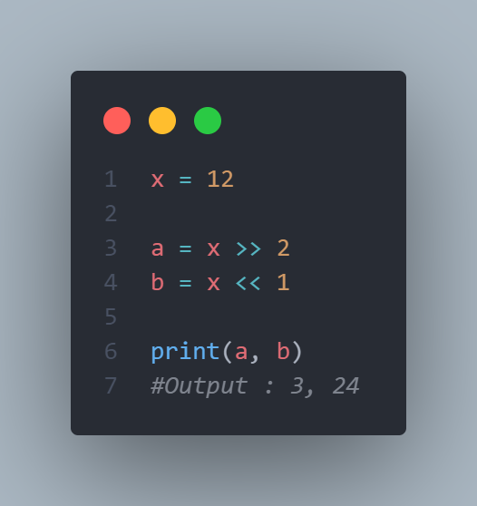
Expressions
Logical Expressions:
Results are either in True or False. It basically specifies one or more conditions.
Bitwise Expressions:
Computations are performed at bit level.

Slide 14
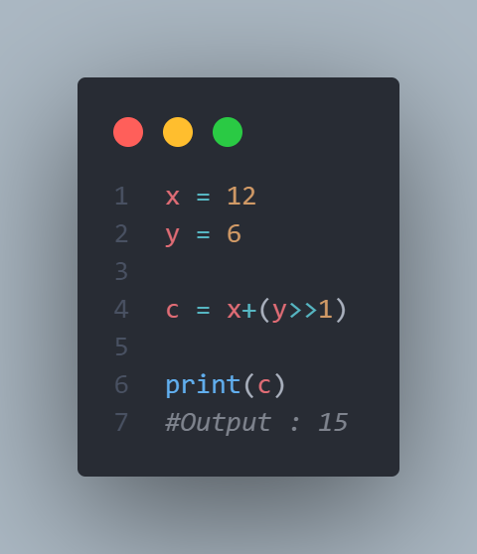
Expressions
Combinational Expressions:
Use different types of expressions in a single expression.

